Slide 1
Identifying Agricultural Weeds with CNN
By Paula Madetzke

Slide 2
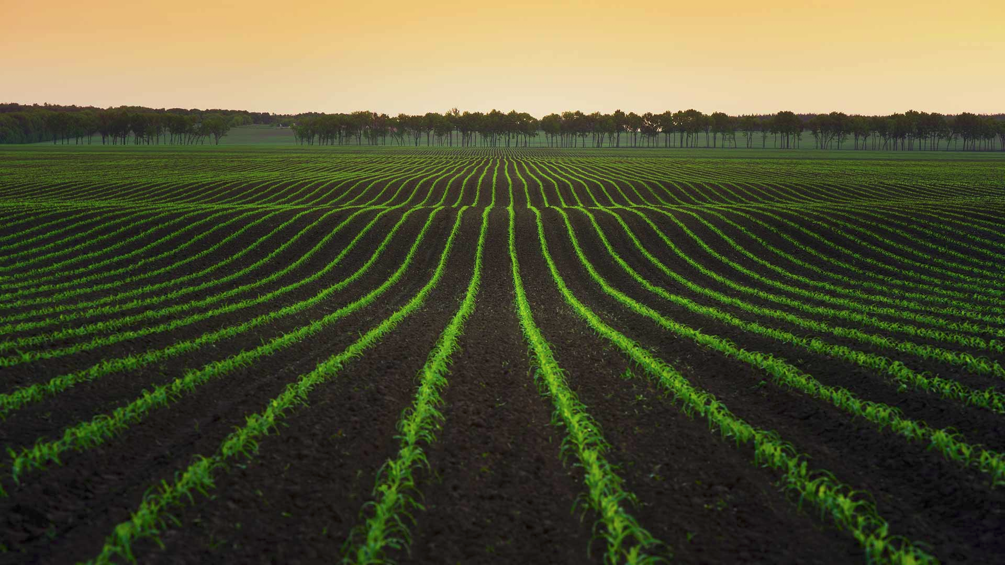
The Problem
With a growing population, more food must be produced to feed them all
Current agricultural practices can harm the environment and are inefficient
Targeting use of chemical treatments can help with both the environment and efficiency

Slide 3
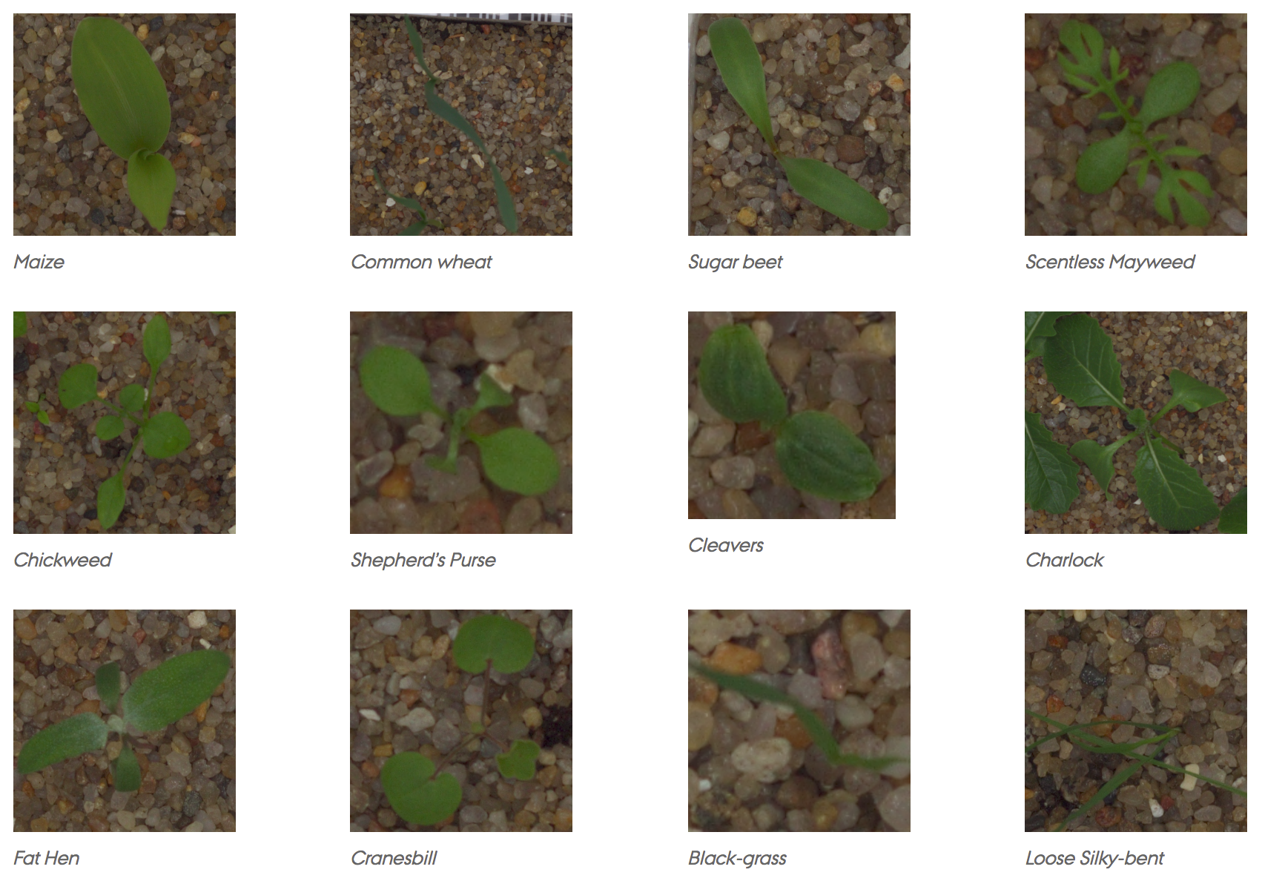
The Dataset and Algorithm
Aarhus University Plant Seedling Dataset has images of 960 unique plants of 12 species
Can implement a CNN to train and categorize the seedlings
Implement in Pytorch
Existing work in Keras and with plant diseases

Slide 4
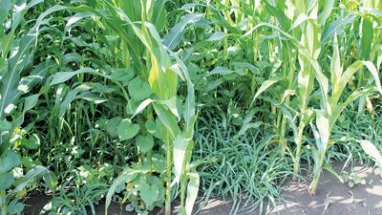
Testing and Visualization
A series of images representing weeds in known locations will be used to test the model
A visualization of the known and test data can be compared to see the accuracy, and location of the weeds

Slide 5
Resources
Aarhus University https://vision.eng.au.dk/plant-seedlings-dataset/
Plant Seedling Classification https://becominghuman.ai/plant-seedlings-classification-using-cnns-ea7474416e65
Oluwafemi Tairu https://towardsdatascience.com/plant-ai-plant-disease-detection-using-convolutional-neural-network-9b58a96f2289

